Slide 1
Regression Chapter 5
CS 637, St. Elizabeth's University, Fall 2021

Slide 2
Regression
We can use regression when modeling deterministic models
Deterministic Models offer some plausible physical explanation for an observed trend
One major difference between stochastic and deterministic models is within deterministic models we extrapolate into the future when making forecasts
Time-series regression differs from standard regression in the fact that residuals tend to be serially correlated
Residuals are defined as the difference between the predicted and true values

Slide 3

Regression
A model for a time-series $x_{t}$ is called linear if $$x_{t}=α_{0}+α_{1}u_{1,t}+α_{2}u_{2,t}+…+α_{m}u_{m,t}+z_{t}$$ for
$u_{i,t}$: Predictor variable i at time t
$α_{i}$: Model coefficient for predictor i
$z_{t}$: Error at time t
Linear regression models are considered non-stationary when they include functions of time
Note: we can also define a linear relationship with higher order polynomials (that is, integer exponents greater than one attached to each predictor variable). The term linear comes from the summation of each term

Slide 4
Lecture 5.RMarkdown
Regression

Slide 5
Generalized Least Squares
Within linear time series models we tend to expect residuals to be autocorrelated
For a positive serial correlation in the residual series, this implies that the standard errors of the estimated regression parameters are likely to be underestimated
Generalized Least Squares (GLS) can be used to provide better estimates of the standard errors of these parameters to account for autocorrelation
We can fit these models in R using the gls() function

Slide 6
Lecture 5.RMarkdown
Regression

Slide 7
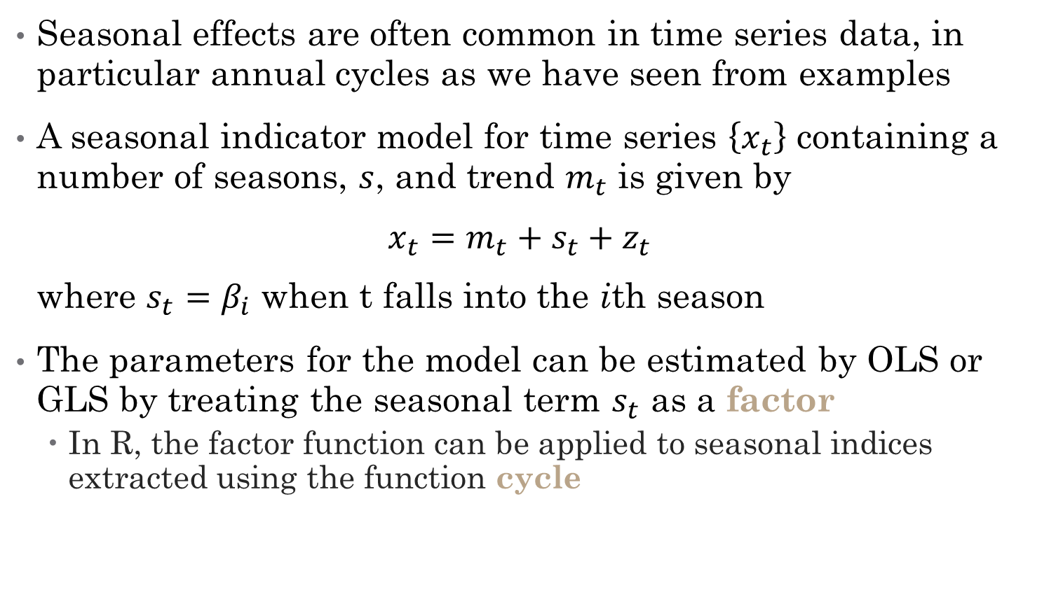
Linear Models with Seasonal Variables
Seasonal effects are often common in time series data, in particular annual cycles as we have seen from examples
A seasonal indicator model for time series $\left\{x_{t}\right\}$ containing a number of seasons, $s$, and trend $m_{t}$ is given by $x_{t}=m_{t}+s_{t}+z_{t}$ where $s_{t}=β_{i}$ when t falls into the ith season
The parameters for the model can be estimated by OLS or GLS by treating the seasonal term $s_{t}$ as a factor
In R, the factor function can be applied to seasonal indices extracted using the function cycle

Slide 8
Lecture 5.RMarkdown
Regression

Slide 9

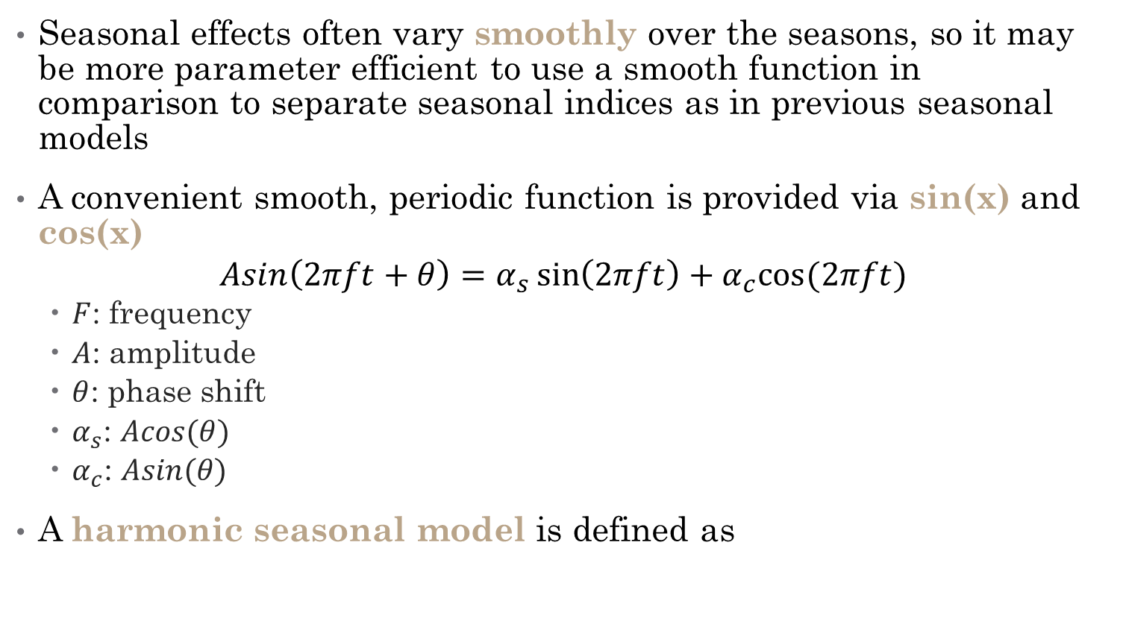
Harmonic Seasonal Models
Seasonal effects often vary smoothly over the seasons, so it may be more parameter efficient to use a smooth function in comparison to separate seasonal indices as in previous seasonal models
A convenient smooth, periodic function is provided via sin(x) and cos(x)
$$Asin\left(2πft+θ\right)=α_{s}\sin\left(2πft\right)+α_{c}cos⁡(2πft)$$
$F$: frequency
$A$: amplitude
$θ$: phase shift
$α_{s}$: $Acos(θ)$
$α_{c}$: $Asin(θ)$
A harmonic seasonal model is defined as

Slide 10

Harmonic Seasonal Models
A harmonic seasonal model is defined as $m_{t}$ is the trend, $s_{i}$ and $c_{i}$ are parameters to be estimated

Slide 11
Lecture 5.RMarkdown
Regression

